Slide 1
Allen Brook College of Data & Engineering (ABCDE) Placement Analysis (Academic Year 2024–2025)
- A Data Analytics Case Study by Anik Chakraborty

Slide 2
🎯 Objective
To develop an interactive Placement Analytics Dashboard to analyze placement performance and key salary drivers for Allen Brook College of Data & Engineering (ABCDE).
Project Purpose:
Evaluate placement outcomes to uncover factors—CGPA, degree background, specialization, gender, work experience—that influence placement success and salary levels.
Build an interactive Excel dashboard for college administrators, career services, and students.
Provide actionable recommendations to improve placement support and student readiness.
Key KPIs:
Overall Placement Rate, Total Students by Gender/Background, Average Salary by Gender/Background, Placement Rate by Gender/Background, Average Salary by CGPA Band, Top-paying Specializations.
Deliverables:
Excel dashboard, presentation slides, and a concise insights report.

Slide 3
📘 Project Overview
Context Highlights:
Analyzed placement records of 215 students from Allen Brook College of Data & Engineering (ABCDE).
Dataset covers academic metrics (degree type, specialization, CGPA), demographics (gender, work experience), and placement outcomes (status, salary).
Demonstrates how data analytics empowers institutional decisions to optimize placement strategies and student performance evaluation.
Built an interactive Placement Analytics Dashboard using Excel (Pivot Tables, Charts, and KPI visuals). Key insights derived on:
Overall placement rate and salary distribution
CGPA-to-salary correlation patterns
Gender and background-based placement trends
Specialization-wise salary contributions

Slide 4
🗂️ Data Overview & Schema
Data Source:
Source: Fictionalized college placement dataset (inspired by open educational datasets).
Data Type: Structured student records and outcomes (placement status and salary).
Time Period: One-time snapshot for the academic year 2024-25.
Data Structure & Metrics:
Key Index Types: Student-level records. Total Rows: 215.
Categories: Approximately 15 features covering three main buckets:
Demographics: Gender, Work Experience (Yes/No).
Academics: Secondary percentage (ssc_p), Higher Secondary percentage (hsc_p) & background (hsc_b), Degree percentage (degree_p) & degree type (degree_t) and MBA percentage (mba_p) - Backgrounds/Types Specialization – Mkt&Fin / Mkt&HR
Placement: Placement Status and Salary.
Calculated Metrics: Binary Placement Status (placement_flag = 1/0) derived for classification modeling.

Slide 5
💻 Tech Stack
Tools:
Microsoft Excel
Data cleaning & preprocessing
Pivot Tables for aggregation
Pivot Charts for visualizations
Slicers/filters for interactivity
Dashboard creation
PowerPoint
Presentation and final dashboard snapshots

Slide 6
📈 Methodology & Analysis
Prepare, Process & Analytical Approach:
• Removed missing or inconsistent values to ensure clean and reliable data.
• Standardized categorical fields such as Degree Type and Specialization for uniformity.
• Grouped CGPA into defined ranges (e.g., 5.00–5.99, 6.00–6.99) for better aggregation.
• Created derived fields like placement_flag (1 = Placed, 0 = Not Placed) to support KPI analysis.
• Descriptive Analytics: Measured overall placement rate and examined distributions by gender, specialization, and degree type.
• KPI Analysis: Calculated % of students placed, average salary, and salary extremes (highest & lowest).
• Correlation Analysis: Explored the relationship between CGPA and salary, and between placement status and CGPA.
• Pivot Tables – for summarizing placement and academic metrics.
• Pivot Charts – to visualize trends and comparisons.
• Slicers & Filters – to add interactivity for dynamic analysis.

Slide 7
❓ Problem Statement
College often collect detailed placement data, but it remains scattered and underutilized, leading to limited visibility into placement performance, salary trends, and academic correlations.
Without consolidated insights, it becomes difficult to identify performance gaps or guide students effectively.
Key Questions: • What is the overall placement rate of the college?
• How do CGPA and specialization influence placement and salary outcomes?
• Are there gender-based or academic background-based differences in placement results?
• What are the average, highest, and lowest salary patterns across different student segments?
• How can the college leverage these insights to improve placement strategies and student preparedness?

Slide 8
💡 Key Insights
Top Findings:
• Placement Rate: 69% of students (148 out of 215) were successfully placed.
• Gender Gap: Males earned a higher average salary (₹2.15 LPA) compared to females (₹1.69 LPA).
• Academic Background: Students from Science & Tech backgrounds achieved the highest average salary (~₹2.19 LPA).
• Specialization: Marketing & Finance students earned 57% higher salaries and had better placement rates than Marketing & HR students.
• CGPA Correlation: Salary increased steadily with CGPA — students with 8–9 CGPA earned an average ₹3.45 LPA.
• Work Experience: Students with prior work experience showed slightly higher placement success and pay levels.
Supporting Metrics:
• Average Salary (Placed Students): ₹4.5 LPA
• Highest Salary: ₹9.6 LPA
• Lowest Salary: ₹2.4 LPA
• Placement by Specialization: Mkt&Fin – 72%, Mkt&HR – 61%
• Trend: Clear positive correlation between CGPA and Salary

Slide 9
📍 Conclusion
Summary: The placement analysis of Allen Brook College of Data & Engineering reveals distinct trends in student performance and employment outcomes.
Science & Technology students consistently secure the highest salary packages, while Commerce & Management has higher student participation.
A strong positive correlation exists between CGPA and salary, confirming that academic excellence directly enhances placement prospects.
Specialization and gender continue to influence placement outcomes, highlighting areas for institutional focus.
The interactive dashboard delivers a concise, data-driven overview of college placement performance — enabling administrators to refine career support strategies, align curriculum with industry trends, and help students understand key drivers of salary and employability.
Overall, this project demonstrates the power of data analytics in driving academic and placement excellence.

Slide 10
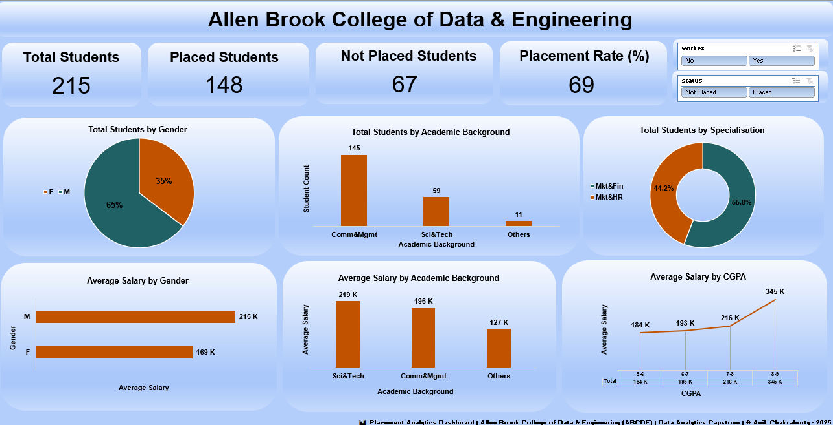
🖥️Dashboard Overview

Slide 11
✅ Business Impact & Use Cases
College Administration & Management: Leverage placement analytics to evaluate program performance, identify academic strengths and gaps, and plan strategic improvements in training and curriculum.
Training & Placement Cell: Use data-driven insights to monitor placement trends, target underperforming student groups, and strengthen industry partnerships through transparent reporting.
Faculty & Academic Departments: Understand how academic background and specialization influence placement outcomes, guiding curriculum updates and mentorship strategies.
Students & Career Advisors: Gain awareness of how CGPA, specialization, and skill development affect placement chances and salary expectations, helping tailor preparation plans.
Recruiters & Industry Partners: Access data-supported insights on student quality, academic diversity, and performance trends to optimize recruitment strategies and hiring pipelines.

Slide 12
🙏 Acknowledgement & Contact
Project Analyst: Anik Chakraborty 📧 Email: anikc1710@gmail.com
Special Thanks To:
Coding Ninjas – for project framework and guidance
Connect: 🔗 GitHub | 🔗 LinkedIn

Slide 13
Thank You!

